Slide 1
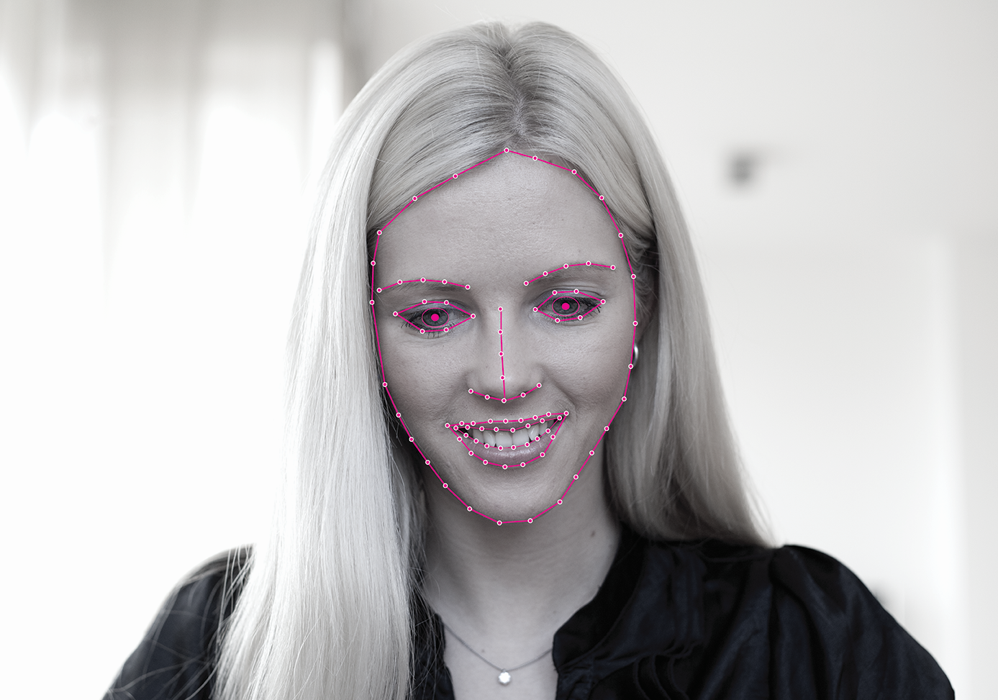

Notes:
Good Afternoon Ladies and Gentlemen. My name is Martin Salo and I’m the co-founder and product director of Realeyes. I’m very excited to be with you here today.
Every once in a while completely new market research methodologies emerge which revolutionize the whole industry.

Slide 2


Surveys
Notes:
Surveys have been here for ages and they are the baseline, but they have also had many issues so people have been looking for better ways to capture the behaviour of people

Slide 3



Sentiment Analysis
Notes:
Not so long ago, the ever-increasing textual data made it possible to do sentiment analysis by mining patterns in text. That was a long-overdue development, making it possible to analyse the behaviour of large groups of people in scale. A much needed improvement over surveys.

Slide 4



EEG And Other In-lab Hardware
Notes:
We’ve also seen many developments in custom hardware that you can attach to someone and then measure their brainwaves or other biometric signals, giving unprecedented detail into the inner workings of ones mind, that was not possible with surveys.

Slide 5










Revolutionary New Approach to Market Research
Notes:
Today, I’m going to introduce you to a completely new approach to market research that can scale as well as sentiment analysis and gives you the same level of detail as you see with in-lab hardware solutions!

Slide 6
Automated Facial Coding
Notes:
The technical term for it is Automated Facial Coding. Before I explain what it means, let’s take a look at current research methodologies.

Slide 7
Research Methods
Cost & time efficient
Online Surveys
Sentiment Analysis
Automated Facial Coding
Online Communities
Focus groups
& interviews
Online Qual
IAT
Eye-Tracking
Galvanic Skin Response
EEG
In-Store Reseach
Cost & time prohibitive
Dial-Testing
Reported behavior
Actual behavior
Notes:
If we plot the methods simply by whether they are based on reported or actual behaviour and whether they are cost and time efficient or not, we see that there is a wide range of options available. We see the all familiar surveys, focus groups, special hardware, sentiment analysis - but very few get to the upper right corner which would be desirable. This is exactly where automated facial coding stands.

Slide 8
Some of The Current Issues
Survey biases and non-response
Sentiment Analysis not specific enough
Expensive hardware
Labs can’t reach audiences
Low predictive power
Notes:
We see many difficult issues that people try to work around by evolving the existing methods. Not all of the tries have been successful. We still struggle with biased responses to surveys – people really don’t do what they say they would. Sentiment analysis is excellent on large scale and for generalisations, but often lacks in detail to provide actionable information on specific content or comes too late. Getting people to labs to measure them in more detail with specially built hardware is cost prohibitive and it’s questionable how naturally people behave in such environments. Many methodologies also suffer from low predictive power – it’s like if there’s something out there that we’re missing. So what is it that we can do differently?

Slide 9
What’s Automated Facial Coding?
Notes:
This brings us back to automated facial coding. So what is it exactly? Let’s take a look.

Slide 10
Live Demo
Notes:
It’s a technology which makes it possible for a computer to automatically measure your expressions and emotional states based on any webcam video feed. I’m using a completely ordinary MacBook Pro without any special hardware– it works with pretty much any device that has a camera on it.
How amazing is that?!!
It can detect if I’m happy or surprised or angry and many other combinations that occur in natural environments at peoples homes.
Many smart people have spent years researching this to make it possible.

Slide 11

Offline Demo
Notes:
Let’s take a closer look. A few people have given us permission to use their facial recordings taken at their homes while watching videos.
The green trace shows the intensity of the happiness over time. The red line shows the current position. We can see how shaking of the laptop, headpose changes or speech doesn’t interfere, neither do other emotions. This is pure unfiltered data of the classifier without any smoothing or doctoring.
Just look at how far the technology has developed! The sensitivity and detail of it is absolutely amazing.

Slide 12

Revolutionary Computer Vision Algorithms
Years of research
Subconscious response
Unfiltered, unbiased
Works in difficult conditions
Cross cultural
Notes:
So let me re-cap. Years of research. Subconscious response, unfiltered, unbiased. Works in difficult conditions in peoples home, moving about, eating, speaking. Works across cultures – the basic 6 emotions happy, angry, sad, disgusted, scared, surprised have been found to be universal. Even people who have been blind their whole life display these – they couldn’t have learned the expressions by watching others.

Slide 13
Hardware Ecosystem
Billions of devices with cameras
Q1 2013 Sales
  212M Smartphones
  50M Tablets
  40M Notebooks
No extra cost of hardware
No lab setup
Affordable
Notes:
Probably many of you are thinking now how many cameras are out there? There’s over a billion! And hundreds of millions of new devices are sold every quarter which have cameras in them. It’s an amazing number - 300 million is almost as much as the entire population of united states. We see that from our statistics as well – it’s very easy to find people with webcams. And best of all, this is all there today which means no extra cost for researchers.

Slide 14
Browser Based, No Installs Or Downloads
Panels
Social networks
Websites
Video players
Quick turnaround
Easy integration
Reach difficult demographics
Notes:
All of the software lives in the cloud. There’s nothing to install for the users, which means we can capture their expressions from any webpage without friction! We can source people from regular panels. We can capture people from social networks or even put the tracker on the front page of New York times. It also simplifies integration and provides ways to reach difficult demographics groups that would never visit a lab.

Slide 15
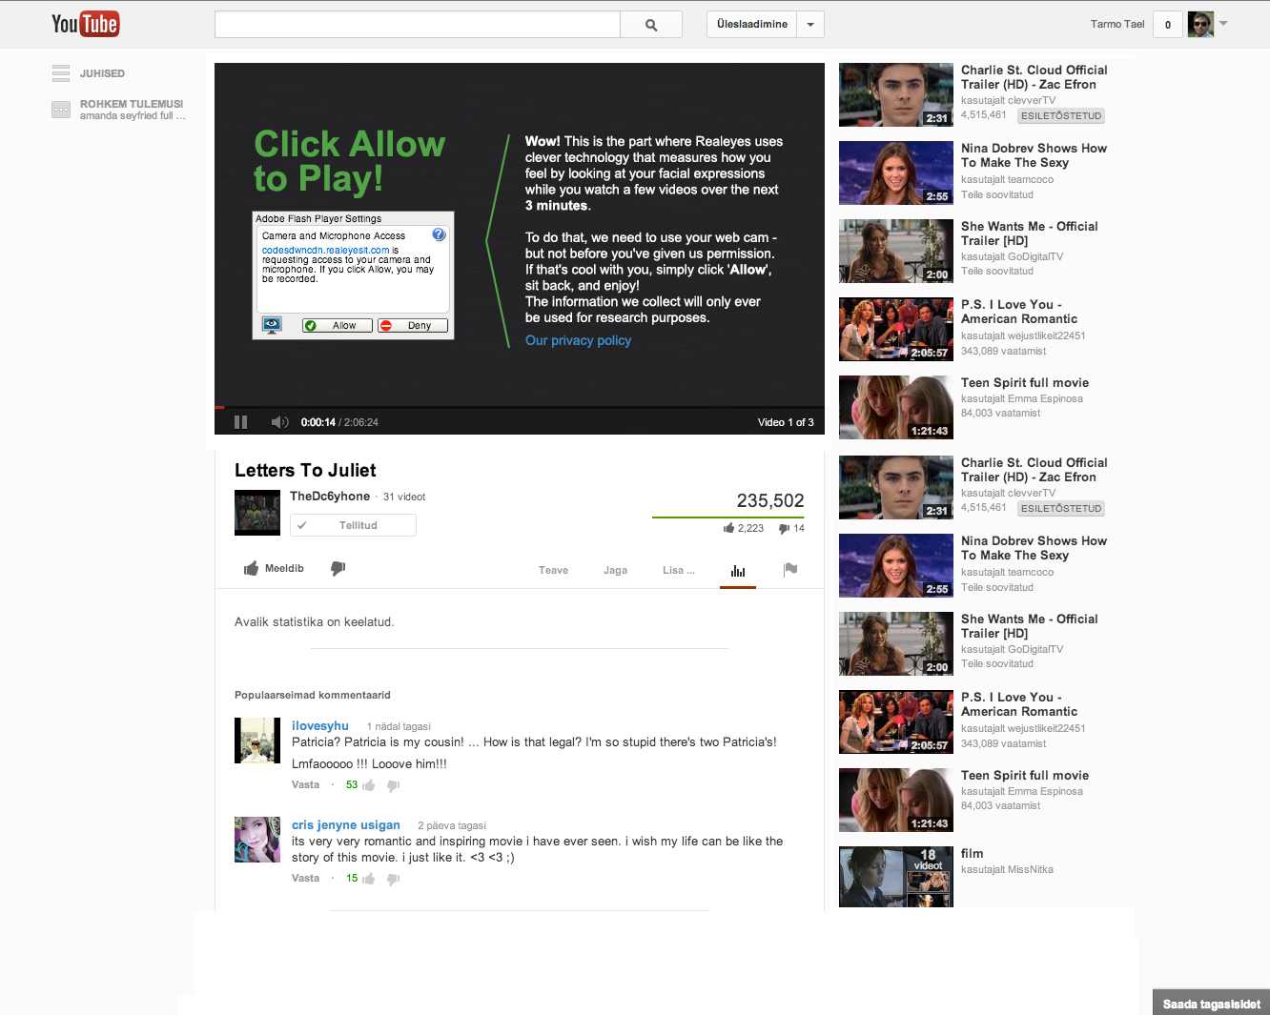
Notes:
Here is an example of the webcam opt-in dialog embedded inside the Youtube player. Imagine tracking thousands of people like that.

Slide 16
Automated Facial Coding
Latest Computer Vision algorithms
Culturally universal emotions
Unfiltered, unbiased response
Amazing turnaround speed
Access to millions of users
No upfront hardware cost
Dense, detailed data
Notes:
So let me recap quickly: We have latest computer vision algorithms, reading your facial expressions and detecting emotions which are culturally universal. It captures the unfiltered and unbiased response of the users – it all happens subconsciously. Because it’s online, we have access to millions of people at the click of a button.

Slide 17
How Is It Being Used?
Notes:
So what do people use it for? How does it work in practice?

Slide 18
Which ad should we air on Super Bowl and why?
Notes:
Let’s s imagine we’re a big company, we’ve produced a few clips and now we want to know which ad should we air at our 30 second slot that cost 4 million dollars so that we get most out of that exposure?

Slide 19
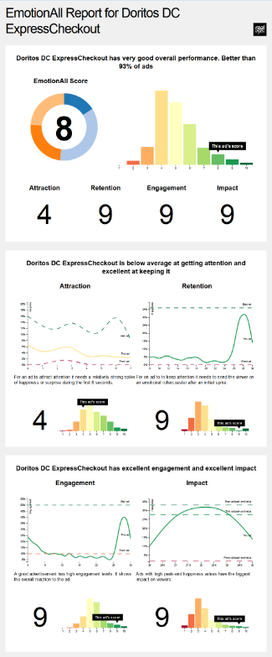
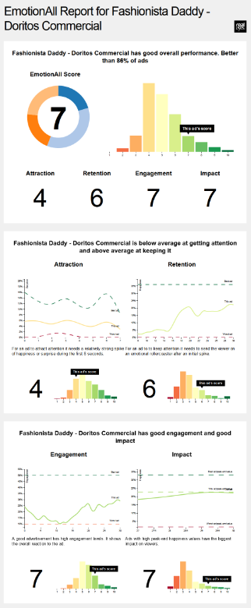
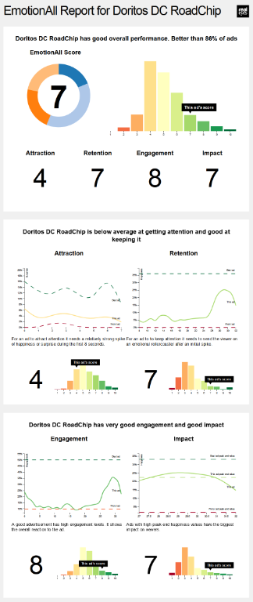
Notes:
We send the videos in question around to a few hundred people and while they watch them, we record a video of their face. Computer reads their expressions and the overall response over the group will be calculated – this all happens in real-time in the cloud.
Naturally companies are interested that their video is engaging, people feel good after it and are likely to purchase more. They also want to minimize the probability of the ad being skipped.
We and other groups have been researching those attributes of ads and certain patterns have emerged. So we simply tell which video attracts and retains attention the best and what’s the takeaway emotion and feeling after watching the ad.
Nice and simple A/B testing

Slide 20
How to edit the ad to be more attractive?
Notes:
Let’s say the ads weren’t performing too well – what could you do?

Slide 21
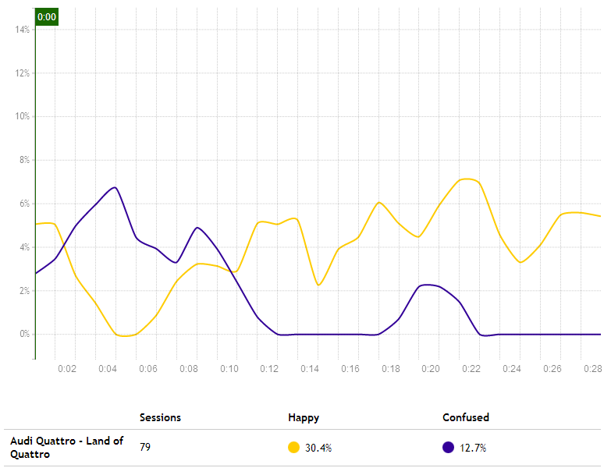
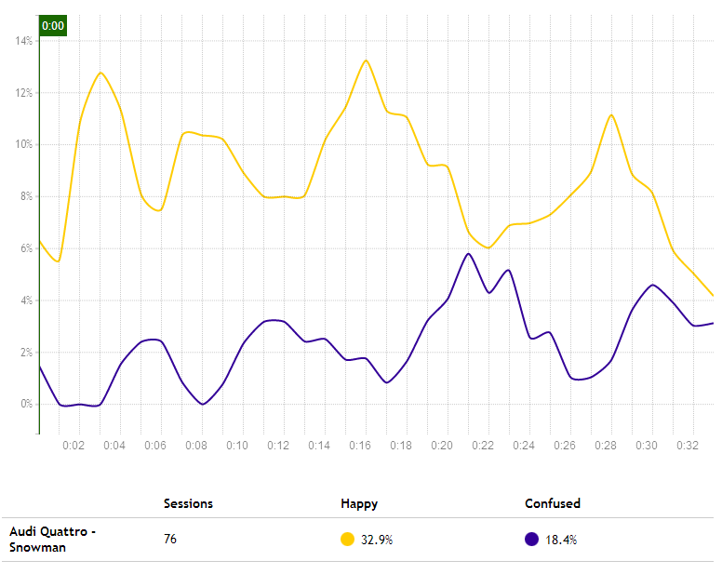
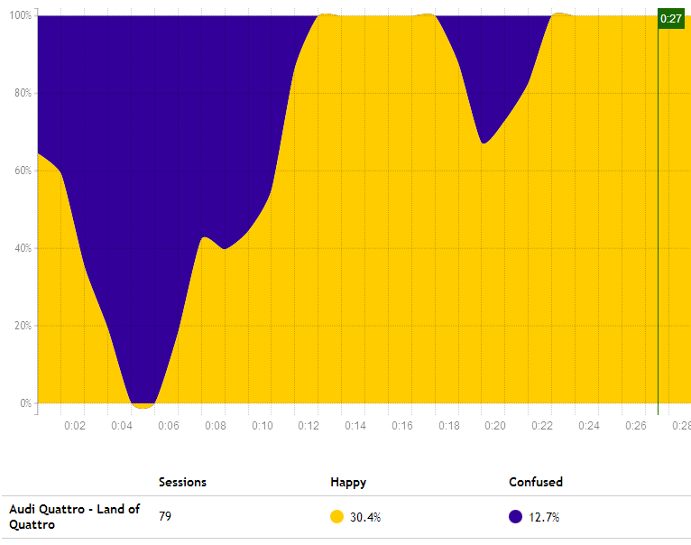
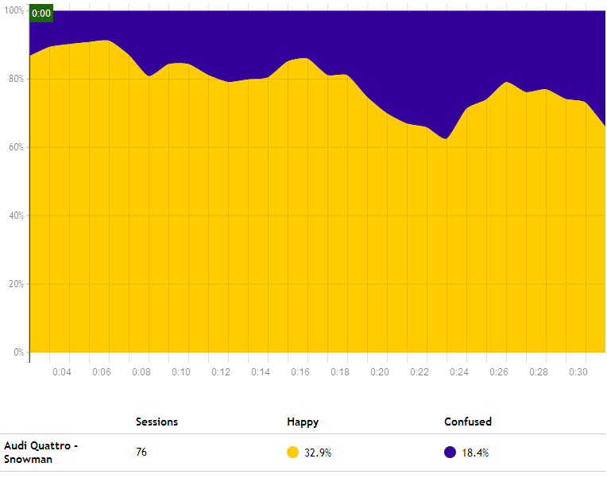
Bad start, good ending
Good start, bad ending
Cut that out!
Change the start completely
Notes:
Again, there are know patterns that make for a good performing video. Here we look at two version of ads for the same product. We look at the saturation of emotions, how much there’s confusion and happiness. It clearly shows certain parts that could be re-worked to create a better overall ad.

Slide 22
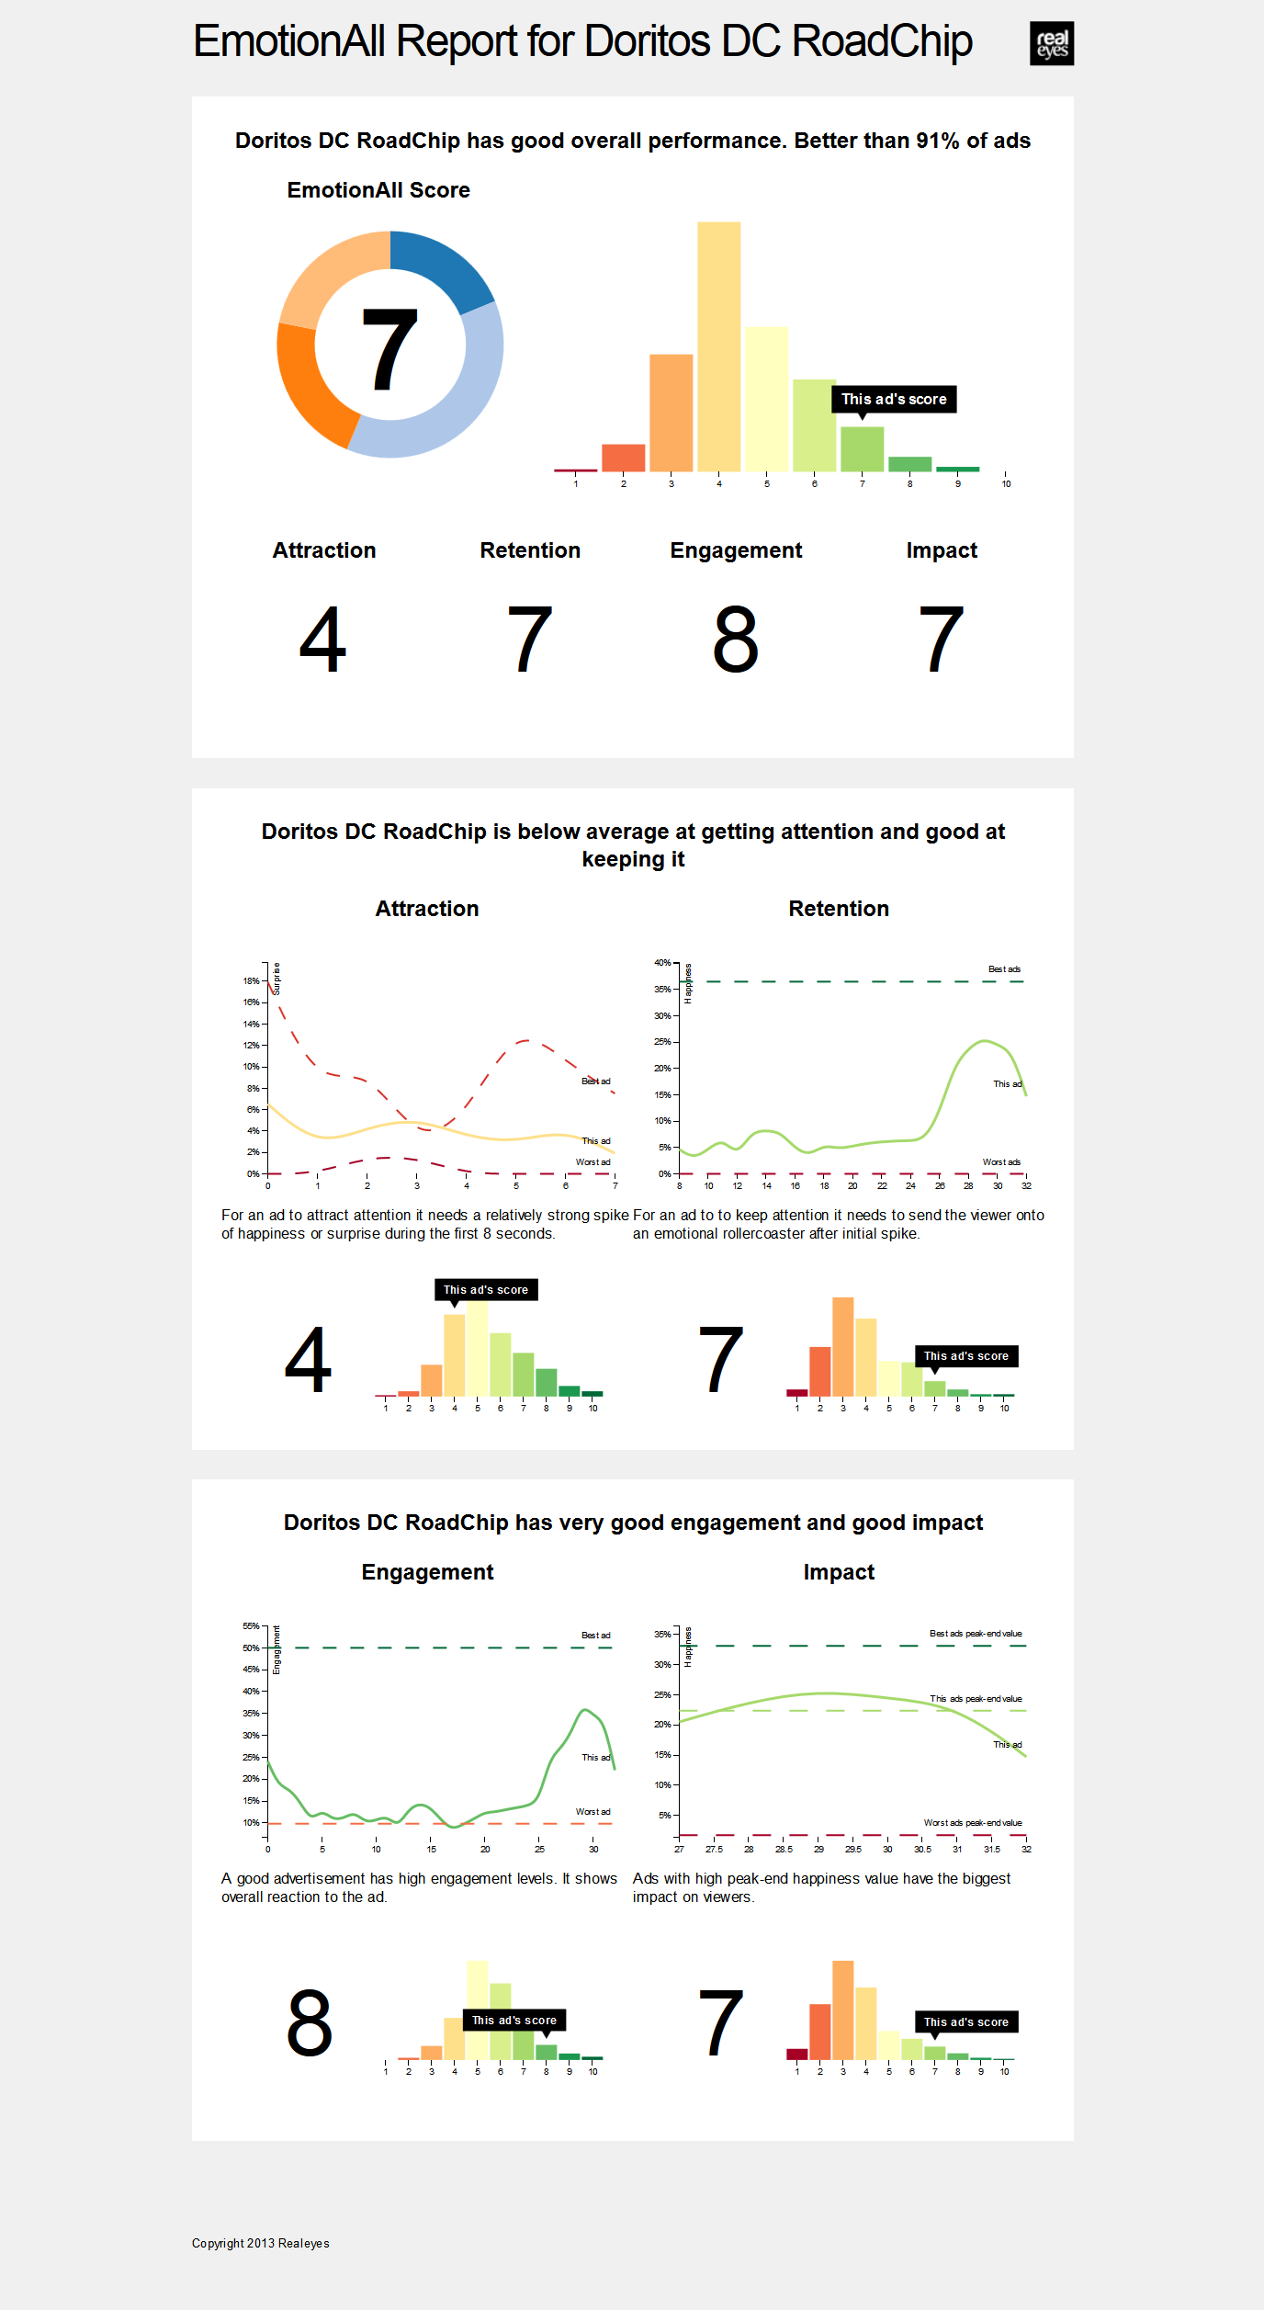
How will the ad perform in social media?
Number of shares and views
View-through and skip rates
Lift in sales and subscriptions
Lift in brand recall
Lift in share of voice
Notes:
Now that the expensive TV ads are cleared for launch, we turn to online digital campaigns. We’ve collected data to find patterns of what make a successful online ad.

Slide 23
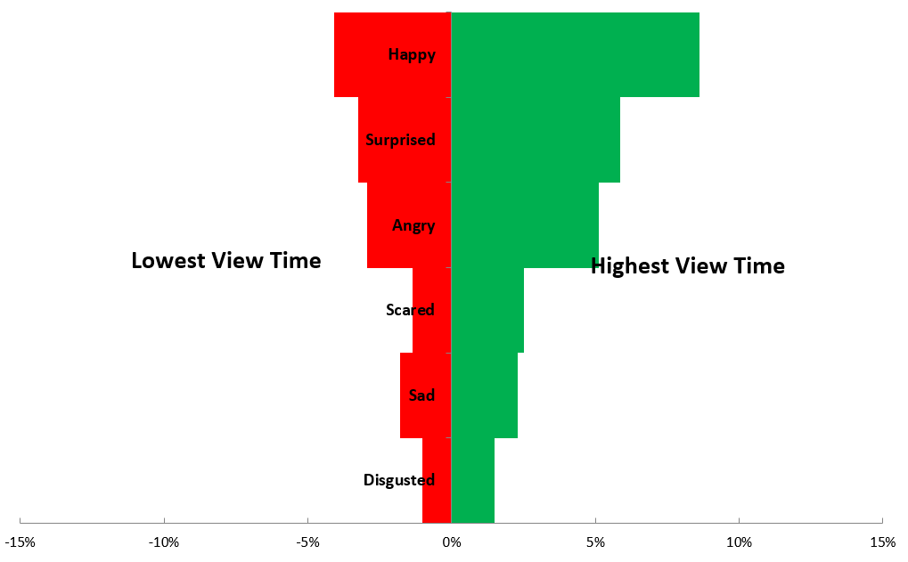
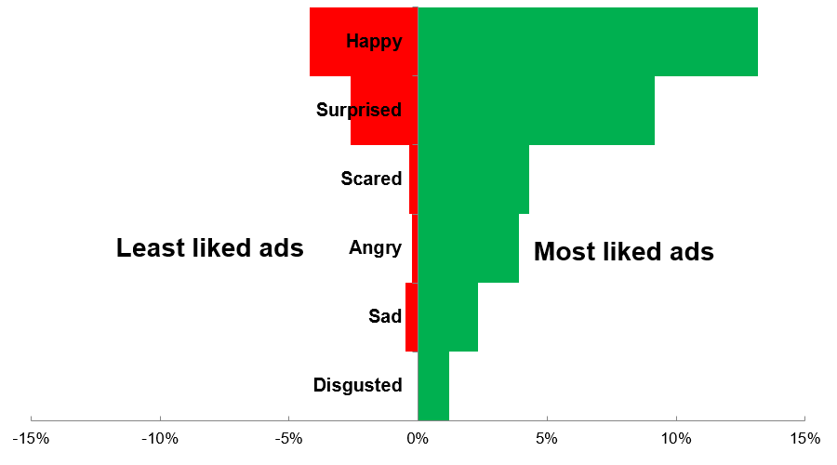
Emotions >
Results
Notes:
Here you can see some of the differences between the best and worst performing digital ads. The profiles of emotion levels are certainly distinct and you can easily see where your ad lands relative to these profiles.

Slide 24
How do I perform relative to others?
Notes:
Now that ads have been launched, I might want to see how to plan my future ad strategy. Which ads to build, how are my competitors doing and what I should do differently.

Slide 25
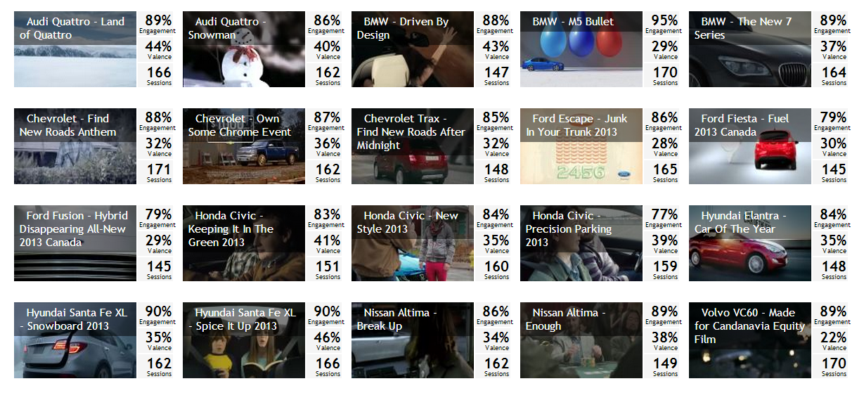
Notes:
We can run through all our competitors ads. Getting this level of data was previously unthinkable. Running all the competitors ads would have been prohibitively expensive, but thanks to the scalability of facial coding, companies could now easily afford it, which allows to answer many more research questions.

Slide 26
Automotive Study | EmotionAll Score | Attraction | Retention | Engagement | Impact
Hyundai Santa Fe XL - Spice It Up 2013 | 8 | 4 | 10 | 9 | 7
Nissan Altima - Enough | 7 | 7 | 7 | 7 | 5
Volvo VC60 - Made for Candinavia Equity Film | 6 | 8 | 5 | 6 | 5
Chevrolet Trax - Find New Roads After Midnight | 6 | 5 | 5 | 7 | 5
Hyundai Santa Fe XL - Snowboard 2013 | 6 | 5 | 6 | 6 | 6
Audi Quattro - Snowman | 6 | 10 | 4 | 6 | 4
Nissan Altima - Break Up | 6 | 5 | 5 | 7 | 4
Volvo XC60 - Made for Candinavia | 5 | 6 | 4 | 6 | 4
Chevrolet - Own Some Chrome Event | 5 | 6 | 4 | 6 | 3
Chevrolet - Find New Roads Anthem | 5 | 6 | 3 | 6 | 4
Honda Civic - New Style 2013 | 5 | 4 | 4 | 7 | 4
Honda Civic - Precision Parking 2013 | 5 | 6 | 4 | 5 | 3
Ford Fiesta - Fuel 2013 Canada | 5 | 7 | 3 | 5 | 3
BMW - M5 Bullet | 5 | 3 | 5 | 5 | 4
Hyundai Elantra - Car Of The Year | 5 | 5 | 4 | 5 | 3
Ford Escape - Junk In Your Trunk 2013 | 4 | 5 | 3 | 5 | 3
BMW - Driven By Design | 4 | 5 | 3 | 5 | 3
Ford Fusion - Hybrid All-New 2013 Canada | 4 | 5 | 3 | 5 | 2
BMW - The New 7 Series | 4 | 5 | 3 | 5 | 2
Honda Civic - Keeping It In The Green 2013 | 4 | 4 | 3 | 4 | 3
Audi Quattro - Land of Quattro | 4 | 3 | 3 | 4 | 3
Notes:
We can easily see how each of them performs how likely they are to be successful. Which brands are best at attracting attention and which one create a more memorable impact.

Slide 27
Notes:
We can drill down and see where they place relative to each other in happiness and surprise.

Slide 28
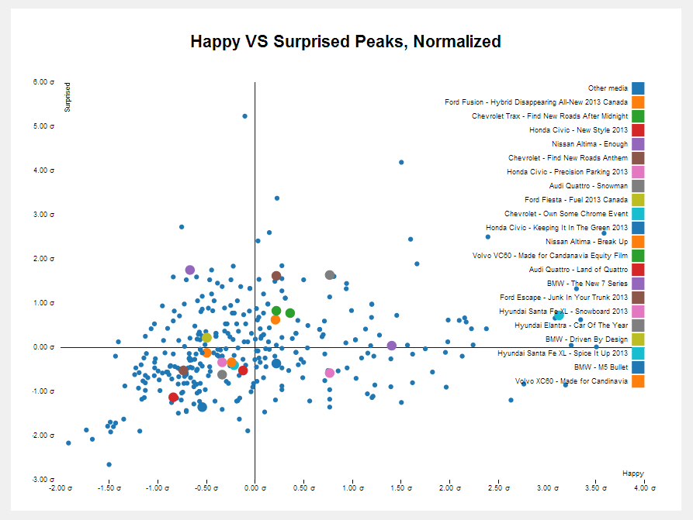
Notes:
And how to they compare relative to all the other similar ads.

Slide 29
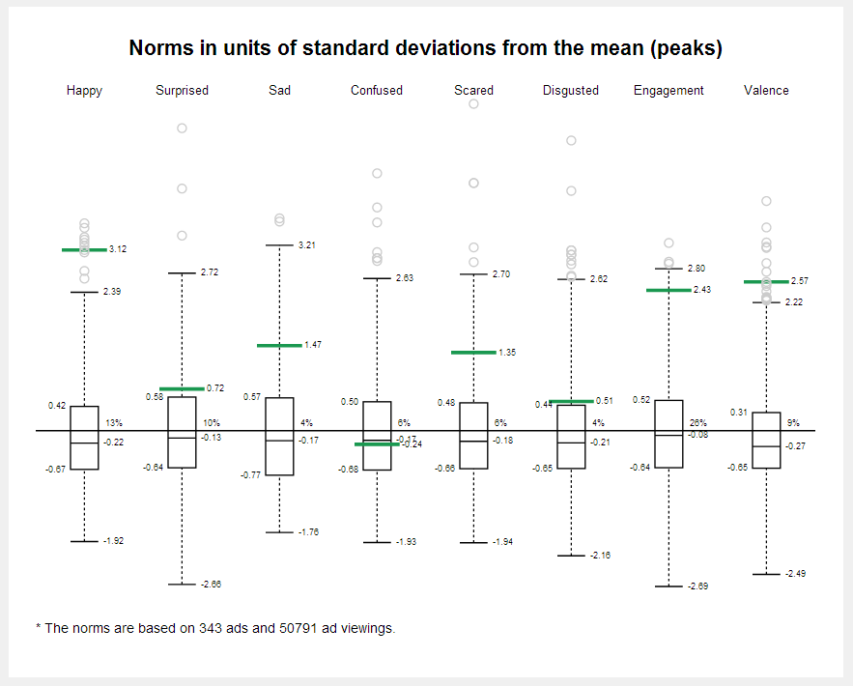
Notes:
And what’s the emotional profile of your target ad relative to the other automotive ads. There are good and bad profiles.

Slide 30
How should I package my product?
Notes:
Now that our ad strategy is clear – how about looking into how to package products? Would that work?

Slide 31
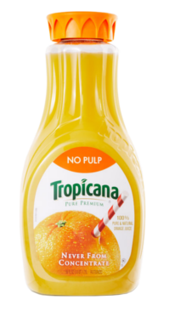
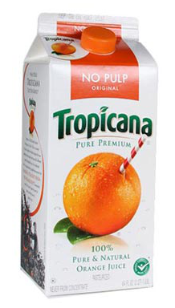

1st
2nd
3rd
Notes:
Here we look at the famous Tropicana case study. It’s the saturation of happiness relative to confusion. The more green the better. And here we can clearly see the emotional effects of different types of packages. These line up perfectly with the real world results where the new plastic packaging raised sales over 55% and where the bottom ad tanked horrible.

Slide 32
How are people behaving in a store?
Notes:
So what else can be done? Amazingly, it can also be applied in brick and mortar retail environments.

Slide 33
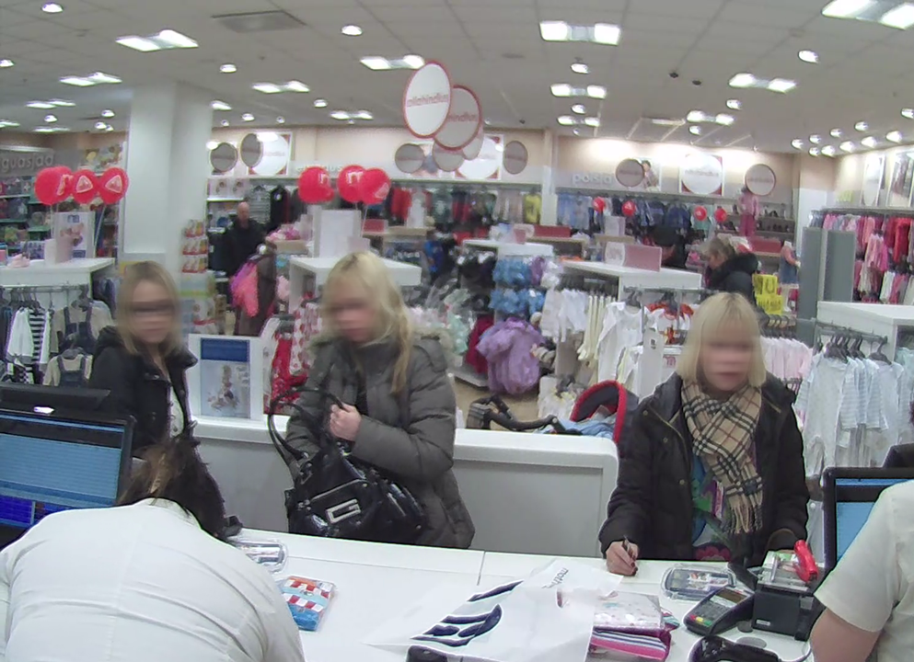
Notes:
We’ve run a study in Estonia, where we’ve measured emotions at point of sale. We’ve established a clear pattern of smiling people making a 67% higher purchase on average! Imagine tracking all store campaigns with such a detail level!

Slide 34
Predictive Modelling
Notes:
Because of the nature of facial coding data, it’s has a lot of promise in enabling new and better models for understanding human behaviour. There’s a lot of possibilities to be discovered when we start combining Sentiment Analysis with Facial coding data! We and other groups have already seen promising results in modelling different real world behaviours.

Slide 35
Emotions are the key!
90% of the decisions are subconscious
Take control of the emotions!
Notes:
Leading neuroscientists claim that roughly 90% of the decisions we make are subconscious. That’s the piece that has been missing all along.
Take control of the emotions and eliminate the unknowns in market research!

Slide 36

Thank you!
Notes:
Thank you for your time! Any questions??

